Slide 1
The Pronator Prosthetic Wrist
By Swapnil Pande and Logan Nofsinger

Slide 2
Project Objectives
Augment currently available terminal devices by designing a wrist to provide an additional degree of freedom
Provide a modular interface to allow a large variety of terminal devices to attach to the wrist
Balance cost vs. mass vs. functionality

Slide 3
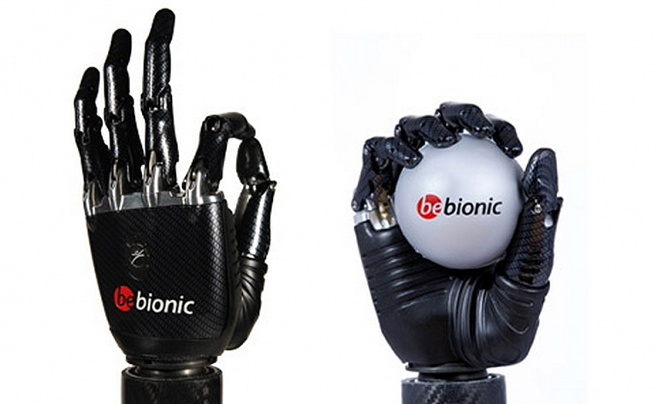
Why make a wrist?
Majority of current research involves highly dexterous terminal devices
(Roy, Wolf, & Scalzitti, 2013)

Slide 4
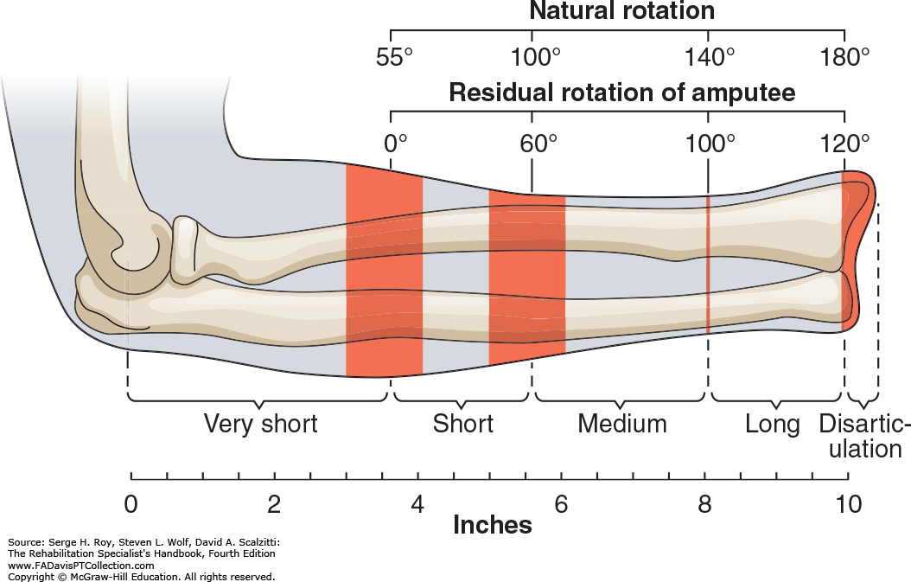
Why Make a Wrist?
Lack of pronation/supination degree of freedom leads to compensatory behavior
(Roy, Wolf, & Scalzitti, 2013)

Slide 5
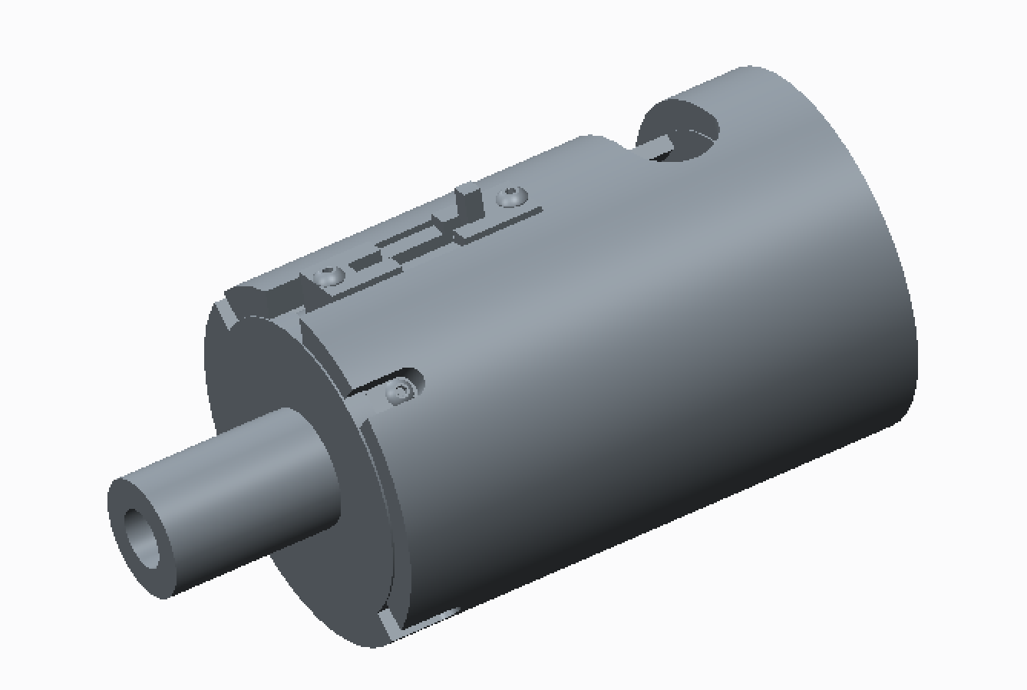
The Pronator

Slide 6
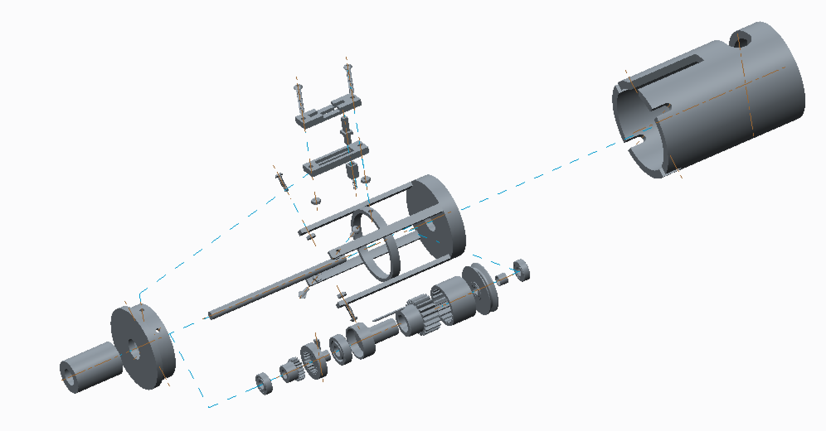
The Pronator

Slide 7
The Pronator
Key Features
1 Rotational Degree of Freedom
Adjustable Rotational Range of Motion
Fully body-powered prostheses
Lockable terminal device position

Slide 8
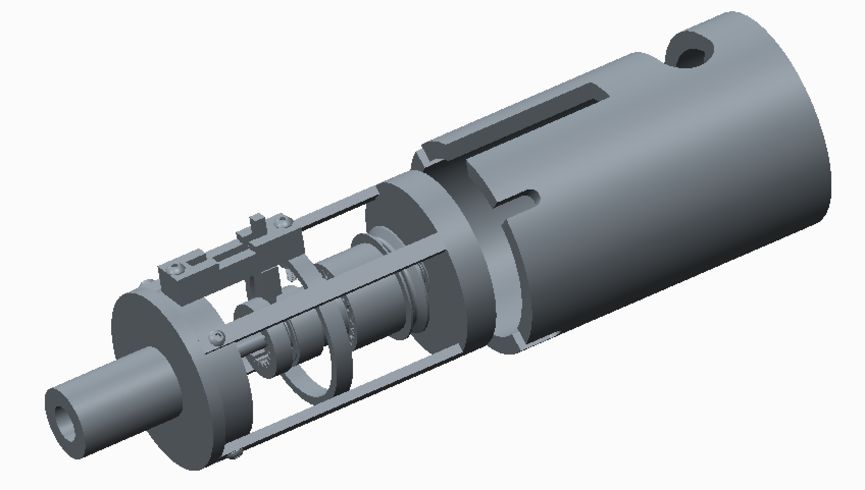
The Pronator – How does it work?

